Slide 1
Using Gaussian Mixture Models to Segment Starting Pitchers Based on Performance in Different Temperatures and Humidity
Cory Boyko

Slide 2

Overview & Hypothesis
Baseball is played from April to October, covering multiple seasons and commonly played outside
Major league teams exist in all parts of the united states
Naturally, games are being played in all types of weather conditions
Temperature and humidity are the most common and changing weather conditions a game is played in
Hypothesis: temperature and humidity affect starting pitchers differently, meaning some pitch better in high temperatures, low humidity, etc. than other groups of pitchers

Slide 3
Literature Review
Past research shows that offense decreases in clear conditions (Kent and Sheridan, 2011) and offense increases in warmer temperatures (Koch and Panorska, 2013)
Konda and yanamoto (2019) found similar results that offense increases in warmer temperatures in the nippon professional league
Other research has shown that weather conditions can affect the baseball itself such as temperature and humidity from the works by Faber and smith (2011) and Kraft and skeeter (1995)
bahill, baldwin, and ramberg (2009) and chambers, Page, and zaidins (2003) studied the effects of the atmosphere on the ball
Elattrache et al. (2011), Bahner, netrer, and rammsayer (1995), and bush-joseph Et al. (2014) studied the effects of weather conditions on the human body
Carl lundgren was one pitcher who pitched exceptionally well in cold weather, but could not pitch well at all in warm weather (Ahrens, 2019)

Slide 4
Methods
The sample consisted of pitchers who started games between 1995 and 2019 who pitched in at least 5 games in high and low categories and 10 games in the average categories
Baseball data came from Retrosheet and weather data came from NOAA
582 pitchers were in the temperature set, 614 in the humidity set, and 537 that were in both sets
1 standard deviation above and below the mean were the cutoffs for the high and low categories
Gaussian mixture models were used to cluster pitchers based on how their statistics changed going from average to high and low
Cluster solutions were chosen based on bic and interpretability

Slide 5
Methods
4 different statistical sets were clustered separately
Offensive statistics: erad (earned run average direct), whip (walks and hits per innings pitched), and XBH (extra base hits)
Style of balls hit in play: ground balls, line drives, and fly balls
3 true outcomes: Walks, strikeouts, and home runs
Command: percentage of pitches thrown being balls
Sets were analyzed for temperature and humidity separately and together

Slide 6
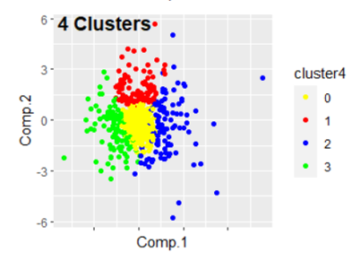
Results & Discussion – Temperature: Offensive
4, 5, and 6 cluster solutions were checked
Most pitchers see little to no change
No cluster strictly preforms better in warm temperatures and worse in cold temperatures
Overall changes are consistent with past research
Temperature does affect pitchers differently
Table 9. 4 Cluster Solution for Temperature – ERAd, WHIP, and XBH
Cluster | Size | ERAd high | ERAd low | WHIP high | WHIP low | XBH high | XBH low
0 | 282 | 0.27 | 0.04 | 0.04 | 0.03 | 0.18 | -0.06
1 | 93 | 1.39 | -1.11 | 0.19 | -0.17 | 0.89 | -0.70
2 | 102 | 1.67 | 1.37 | 0.25 | 0.24 | 0.93 | 0.81
3 | 105 | -1.21 | -0.84 | -0.20 | -0.13 | -0.54 | -0.59

Slide 7
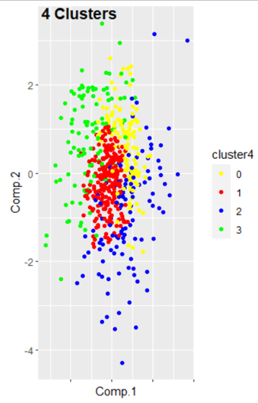
Results & Discussion – Temperature: Style of Batted Balls
4 and 6 cluster solutions were checked
There aren’t clear patterns, but in general if ground balls or line drives change, fly balls change in the opposite direction
The groups aren’t very separable and the changes would have little to no effect on the game
Temperature does not affect the style of balls in plays differently for pitchers
Table 11. 4 Cluster Solution for Temperature – Ground Ball, Fly Ball, and Line Drive
Cluster | Size | Grnd high | Grnd low | Fly high | Fly low | Line high | Line low
0 | 124 | 0.74 | 0.47 | -0.46 | -0.61 | 0.36 | -0.29
1 | 243 | -0.22 | -0.29 | 0.44 | 0.12 | 0.29 | -0.19
2 | 115 | 0.12 | 0.24 | 0.07 | -0.12 | 0.91 | 1.10
3 | 100 | -0.29 | -0.41 | 0.53 | 0.45 | -0.81 | -1.26

Slide 8
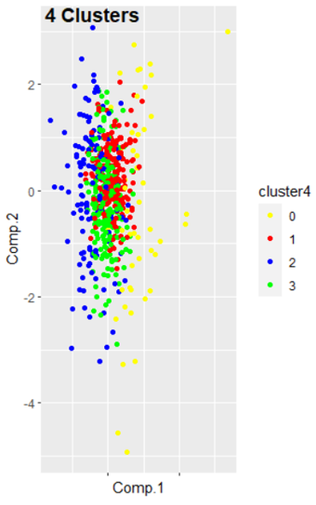
Results & Discussion – Temperature: 3 True Outcomes
4 and 6 cluster solutions were checked
Overall patterns aren’t as clear but looking at each statistic will show differences
Home runs increases across all clusters in high temperatures which is consistent with past research, but one cluster does increase in low temperatures which is differing from past research
Past research shows that strikeouts and walks are flat across high and low temperature, but not necessarily the case here
Temperature does effect pitchers differently
Table 13. 4 Cluster Solution for Temperature – Walks, Strikeouts, and Home Runs
Cluster | Size | HR high | HR low | KK high | KK low | BB high | BB low
0 | 48 | 0.70 | 0.51 | -0.15 | -0.25 | 0.72 | 1.02
1 | 202 | 0.25 | -0.11 | -0.21 | -0.27 | 0.16 | 0.33
2 | 135 | 0.08 | -0.45 | 0.54 | 0.03 | -0.40 | -0.04
3 | 197 | 0.04 | -0.08 | 0.10 | 0.26 | -0.06 | 0.36

Slide 9
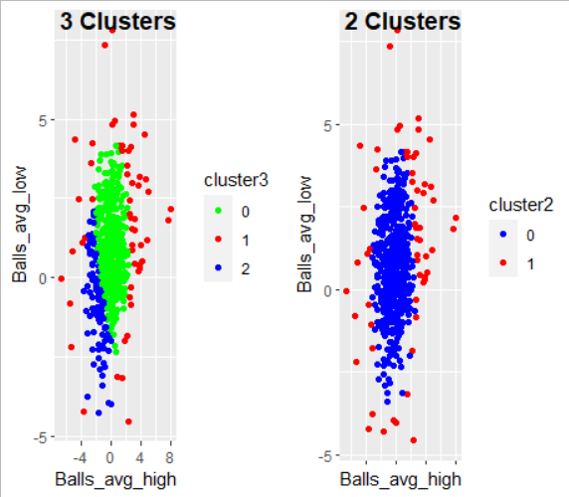
Results & Discussion – Temperature: Command
2 and 3 cluster solutions were checked
Neither cluster is separable
The changes would have practically no effect on the game itself
Temperature does not affect pitchers differently
Table 14. 3 Cluster Solution for Temperature – Ball Percentage
Cluster | Size | Balls high | Balls low
0 | 419 | 0.03 | 1.01
1 | 57 | 1.37 | 1.71
2 | 106 | -1.74 | -0.77
Table 15. 2 Cluster Solution for Temperature – Ball Percentage
Cluster | Size | Balls high | Balls low
0 | 523 | -0.29 | 0.68
1 | 59 | 0.99 | 1.41

Slide 10
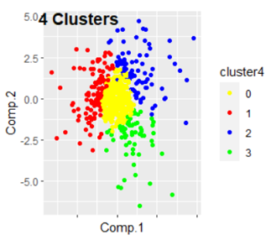
Results & Discussion – Humidity: Offensive
4, 5, and 6 cluster solutions were checked
Most pitchers see little to no change
Erad has the largest changes among the statistics and would have the largest effect on the game
Whip has the smallest changes
Humidity affects pitchers differently
Table 18. 4 Cluster Solution for Humidity – ERAd, WHIP, and XBH
Cluster | Size | ERAd high | ERAd low | WHIP high | WHIP low | XBH high | XBH low
0 | 350 | -0.13 | 0.28 | -0.01 | 0.05 | -0.04 | 0.18
1 | 110 | -1.10 | -1.38 | -0.14 | -0.18 | -0.62 | -0.76
2 | 87 | 2.10 | 0.71 | 0.32 | 0.09 | 1.07 | 0.42
3 | 67 | -0.53 | 2.52 | -0.05 | 0.39 | -0.48 | 1.52

Slide 11
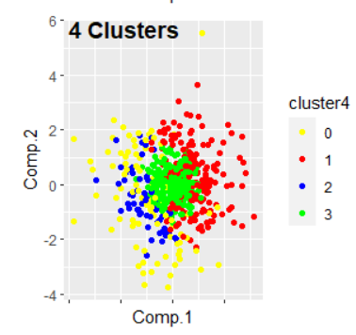
Results & Discussion – Humidity: Style of Batted Balls
4, 5, and 6 cluster solutions were checked
Generally, if fly balls increased, ground balls and line drives changed the opposite direction, but not universally true
No other clear patterns and changes were very small
Humidity does not affect pitchers differently
Table 21. 4 Cluster Solution for Humidity – Ground Ball, Fly Ball, and Line Drive
Cluster | Size | Grnd high | Grnd low | Fly high | Fly low | Line high | Line low
0 | 99 | -0.77 | -1.06 | 0.57 | 0.90 | -0.06 | 0.18
1 | 181 | 0.72 | 0.58 | -0.69 | -0.51 | 0.10 | 0.07
2 | 59 | -1.34 | -0.47 | 1.02 | 0.68 | -0.01 | -0.33
3 | 275 | -0.02 | -0.03 | -0.08 | 0.22 | -0.19 | 0.03

Slide 12
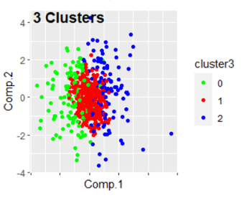
Results & Discussion – Humidity: 3 True Outcomes
3, 4, and 5 cluster solutions were checked
Most pitchers had little to no change
Cluster 0 had preferable changes while cluster 2 had less preferable changes
The changes aren’t that large, but could affect the game
Humidity affects pitchers differently
Table 24. 3 Cluster Solution for Humidity - Walks, Strikeouts, and Home Runs
Cluster | Size | HR high | HR low | KK high | KK low | BB high | BB low
0 | 115 | -0.49 | -0.32 | 0.15 | 0.51 | -0.33 | -0.25
1 | 381 | -0.03 | 0.07 | -0.07 | -0.04 | 0.03 | 0.16
2 | 118 | 0.20 | 0.48 | -0.05 | -0.21 | 0.74 | 0.74

Slide 13
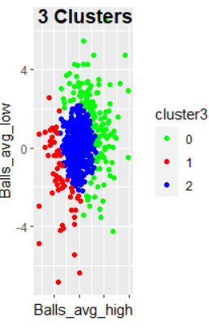
Results & Discussion – Humidity: Command
3and 4 cluster solutions were checked
Changes are larger than the temperature solution, but still not of consequence
Humidity does not affect pitchers differently
Table 26. 3 Cluster Solution for Humidity – Ball Percentage
Cluster | Size | Balls high | Balls low
0 | 134 | 1.86 | 1.31
1 | 63 | -2.36 | -1.40
2 | 417 | -0.01 | 0.15

Slide 14
Results & Discussion – Temperature & Humidity
Looking at the sets together did not add any new information
Offensive: the solutions had analogous clusters in each of the individual solutions
Style of batted balls: similar patterns to the individual solutions, but less separation and lower magnitudes – still not impactful
3 true outcomes: generally similar patterns, but clusters were less clear than the individual solutions
Command: same patterns as the individual solutions, but the magnitudes are still too small to impact the game

Slide 15
Limitations
The sample of 1995 – 2019 includes players from the steroid era of baseball, an era of increased offensive due to the widespread use of anabolic steroids which has since been banned, which may influence results
Erad is very similar to era, but era is the more commonly used statistic. Era was not able to be directly calculated
Many pitchers had to excluded due to playing in a stadium with a retractable dome, but no way to signify if the dome was open or closed
Temperature and humidity weren’t isolated, so there were other outside effects

Slide 16
Future Research
Temperature and humidity were studied separately, but not together. A larger sample could allow for these combinations
Further research can be done on these clusters to see how other statistics are affected by temperature and humidity
Pitching performance has been getting increasingly better over the years, so it will be interesting if these patterns hold
There is still more to study with weather outside of temperature and humidity

Slide 17
References
Ahrens, A. (2019). Carl Lundgren: The Cubs’ Cold-Weather King. The Baeball Research Journal, 48(2), 91–101. Retrieved from http://eds.a.ebscohost.com.proxy-harrisburg.klnpa.org
Bahill, A. T., Baldwin, D. G., & Ramberg, J. S. (2009). Effects of Altitude and Atmospheric Conditions on the Flight of a Baseball. International Journal of Sports Science and Engineering, 3(2), 109–128. Retrieved from https://www.researchgate.net/profile/David_Baldwin8
Bahner, E., Netrer, P., & Rammsayer, T. H. (1995). Effects of Cold on Human Information Processing : Application o f a Reaction Time Paradigm. Integrative Psychological and Behavioral Science, 30(1), 34–45. https://doi.org/10.1007/BF02691388
Bush-Joseph, C., Cohen, M., Erickson, B. J., Md, Harris, J. D., Romeo, A. A., & Tetreault, M. (2014). Is Tommy John Surgery Performed More Frequently in Major League Baseball Pitchers From Warm Weather Areas? Orthopaedic Journal of Sports Medicine, 4(10), 1–6. https://doi.org/10.1177/2325967114553916
Chambers, F., Page, B., & Zaidins, C. (2003). Atmosphere, weather and baseball: How much farther do baseballs really fly at Denver’s Coors Field? Professional Geographer, 55(4), 491–504. https://doi.org/10.1111/0033-0124.5504007

Slide 18
References
Elattrache, N. S., Hurd, W. J., Kaplan, K. M., Jobe, F. W., Kaufman, K. R., & Morrey, B. F. (2011). Comparison of Shoulder Range of Motion, Strength, and Playing Time in Uninjured High School Baseball Pitchers Who Reside in Warm- and Cold-Weather Climates. The American Journal of Sports Medicine, 39(2), 320–328. https://doi.org/10.1177/0363546510382230
Faber, W., & Smith, L. (2011). The Effect of Temperature and Humidity on the Performance of Baseballs and Softballs. Procedia Engineering, 13(1), 200–206. https://doi.org/10.1016/j.proeng.2011.05.073
Kent, W. P., & Sheridan, S. C. (2011). The Impact of Cloud Cover on Major League Baseball. Weather, Climate, and Society, 3(1), 7–15. https://doi.org/10.1175/2011WCAS1093.1
Koch, B. L. D., & Panorska, A. K. (2013). The impact of temperature on Major League Baseball. In Weather, Climate, and Society, 5(4), 359–366. https://doi.org/10.1175/WCAS-D-13-00002.1
Konda, K., & Yamamoto, Y. (2019). Analysis of the Impact of Temperature on Nippon Professional Baseball. 17th International Conference on ICT and Knowledge Engineering. https://doi.org/10.1109/ICTKE47035.2019.8966878

Slide 19
References
Kraft, M. D., & Skeeter, B. R. (1995). The effect of meteorological conditions on fly ball distances in North American major league baseball games. Geographical Bulletin - Gamma Theta Upsilon, 37(1), 40–48. Retrieved from https://www.researchgate.net/profile/Brent_Skeeter
National Centers for Environmental Information. Data Tools: Local Climatological Data (LCD). Local Climatological Data (LCD) | Data Tools | Climate Data Online (CDO) | National Climatic Data Center (NCDC). https://www.ncdc.noaa.gov/cdo-web/datatools/lcd.
Retrosheet, inc. Retrosheet. https://www.Retrosheet.Org/.

